Slide 1
Introduction to Machine Learning – Decision Trees
Dr. Ab Mosca (they/them)
Slides based off slides courtesy of Jordan Crouser (https://jcrouser.github.io/)

Slide 2
Plan for Today
Basic mechanics of tree-based methods
Classification example
Choosing good splits
Pruning

Slide 3
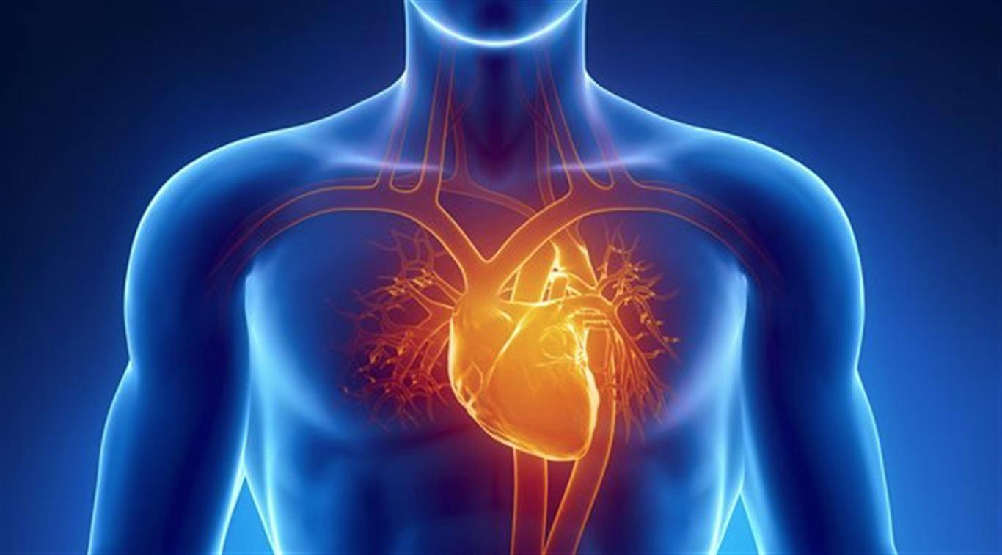
Example: surviving cardiac arrest
Notes:
Preliminary data gathered at Stanford on revival of cardiac arrest patients by paramedics.
Goal: predict which patients can be successfully revived using only what we know at or near the time of paramedic arrival.
e.g., sex, age, time from attack to first care, etc.

Slide 4

Example: surviving cardiac arrest
Notes:
In particular, there are some patients who are not revived on site but are later successfully resuscitated at the hospital. We’d like to be able to identify these cases as quickly as possible.
For the sake of easy explanation, all the values in this example are going to be categorical. So technically the tree we build is going to be a classification tree. If instead the values were continuous, it would be a regression tree. Everything else is the same.

Slide 5
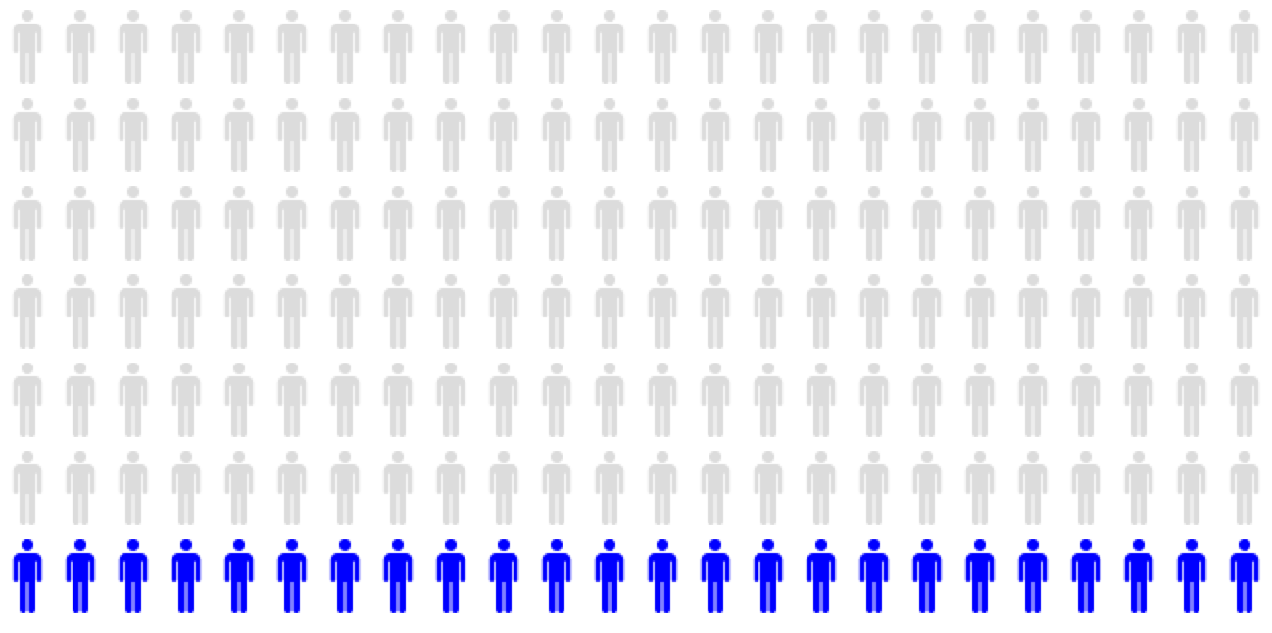
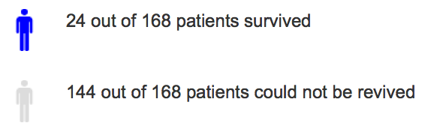
Full dataset: 168 patients
24 of 168 patients survived
144 of 168 patients could not be revived

Slide 6

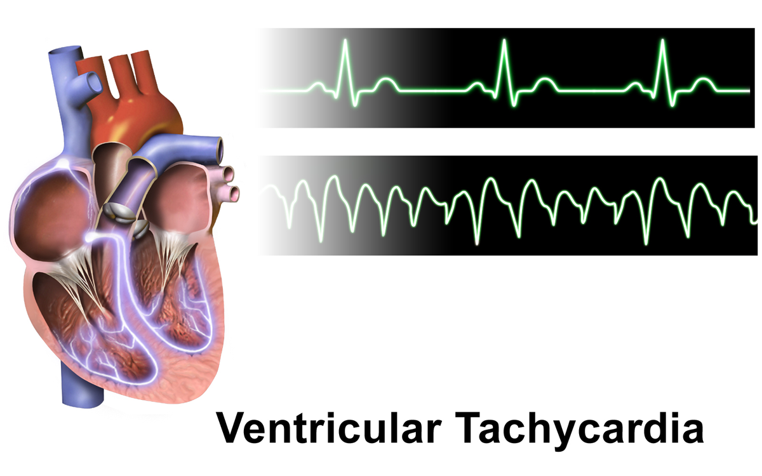
Crystal ball: best predictor
Initial ♥
rhythm
Notes:
Now imagine we have a crystal ball that lets us magically pick the single variable that best predicts survival

Slide 7
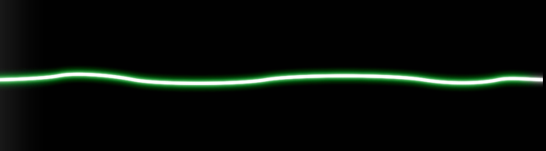
Different types of arrhythmia
Normal
Ventricular Tachycardia (VT) /
Ventricular Fibrillation (VF)
EMD /
Asystole / Other
Images courtesy of Wikipedia

Slide 8
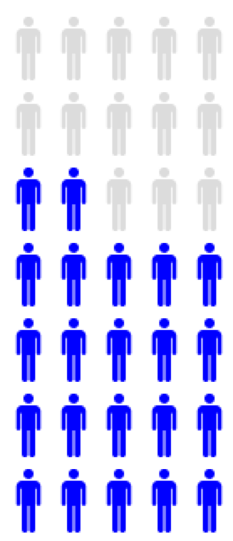
First Split: Initial Heart Rhythm
VT / VF
22 of 35 patients survived
13 of 35 patients could not be revived
Notes:
Ventricular Tachycardia or Ventricular Fibrillation (VT/VF)

Slide 9
First Split: Initial Heart Rhythm
EMD
Asystole
Other
2 of 133 patients survived
131 of 133 patients could not be revived
Notes:
Electromechanical dissociation (EMD)
Flatline (Asystole)
Other

Slide 10

Another view: partitioning
VT / VF
EMD / Asystole / Other

Slide 11
Now what do we do?
VT / VF
EMD / Asystole / Other
Ideas?
Notes:
Now rinse, lather, and repeat!

Slide 12
Recursion!
VT / VF
EMD / Asystole / Other
Notes:
Now rinse, lather, and repeat!

Slide 13
VT / VF group only
22 of 35 patients survived
13 of 35 patients could not be revived
Notes:
Looking only at the VT / VF population, the next variable that best predicts survival is the patent’s initial response to defibrillation.

Slide 14

Next split: response to defibrillation
22 of 35 patients survived
13 of 35 patients could not be revived
Notes:
Looking only at the VT / VF population, the next variable that best predicts survival is the patent’s initial response to defibrillation.

Slide 15
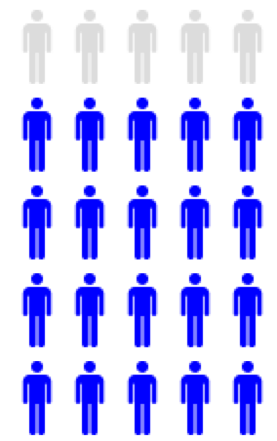

Next split: response to defibrillation
Improve
20 of 25 patients survived
5 of 25 patients could not be revived
Notes:
Looking only at the VT / VF population, the next variable that best predicts survival is the patent’s initial response to defibrillation.

Slide 16
Next split: response to defibrillation
Same / Worse
20 of 25 patients survived
5 of 25 patients could not be revived
Notes:
Looking only at the VT / VF population, the next variable that best predicts survival is the patent’s initial response to defibrillation.

Slide 17
Partition view
VT / VF
EMD / Asystole / Other
+
-
Notes:
Now rinse, lather, and repeat!

Slide 18
Partition view
VT / VF
EMD / Asystole / Other
+
-
Notes:
Now rinse, lather, and repeat!

Slide 19
Next split: response to defibrillation
medication
Next split: response to defibrillation
2 of 133 patients survived
131 of 133 patients could not be revived
Notes:
It turns out that for the patients with more complex cardiac issues, their initial response to defib isn’t a very good predictor of survival.
For this group, we instead want to look at their response to medication.

Slide 20
Next split: response to defibrillation
medication
Next split: response to defibrillation
Improve
2 of 31 patients survived
29 of 31 patients could not be revived
Notes:
Of the 31 patients that responded well to medication, 2 survived.

Slide 21
Next split: response to defibrillation
medication
Next split: response to defibrillation
0 of 102 patients survived
102 of 102 patients could not be revived
Notes:
As for the group that didn’t respond to medication… not a very good prognosis.

Slide 22


Partition view
VT / VF
EMD / Asystole / Other
Different!
-
+
+
-
Notes:
So what do you notice about this?

Slide 23
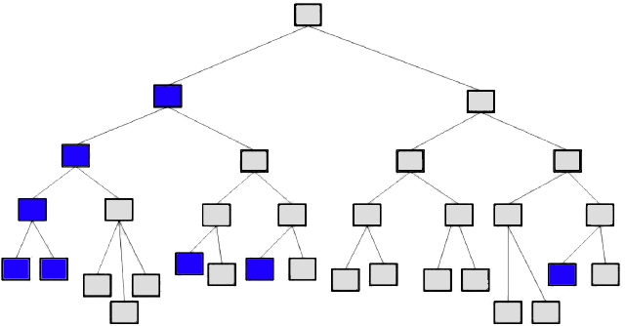
Continue…

Slide 24
Discussion
What could go wrong with this approach?
Notes:
the resulting tree might be too complex, leading to poor test set performance and difficulty interpreting the results

Slide 25
Growing (and pruning) trees
Big idea: build a big tree, then cut off (“prune”) the branches that aren’t improving performance
Notes:
Question: why not just build a smaller tree to begin with?
Answer: this is the same issue we had with our linear model selection methods: a branch that doesn’t seem useful early on may give rise to a better branch further down – if we stop too soon, we’d never know!

Slide 26
Growing (and pruning) trees
Big idea: build a big tree, then cut off (“prune”) the branches that aren’t improving performance
Why not just build a smaller tree to begin with?
Notes:
Question: why not just build a smaller tree to begin with?
Answer: this is the same issue we had with our linear model selection methods: a branch that doesn’t seem useful early on may give rise to a better branch further down – if we stop too soon, we’d never know!

Slide 27
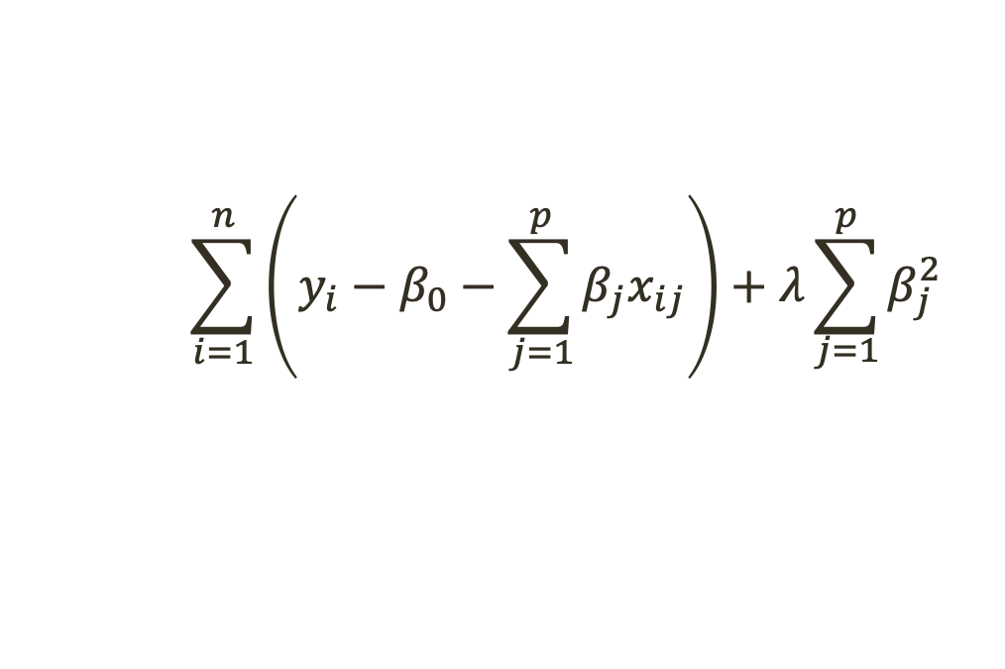
Flashback: the lasso
Big idea: minimize RSS plus an additional penalty that rewards small (sum of) coefficient values
RSS
Shrinkage
penalty
$$\sum_{i=1}^{n}{\left(y_{i}−β_{0}−\sum_{j=1}^{p}{β_{j}x_{ij}}\right)+λ\sum_{\begin{aligned}j=1 \\ \end{aligned}}^{p}{β_{j}^{2}}}$$
Tuning
parameter

Slide 28
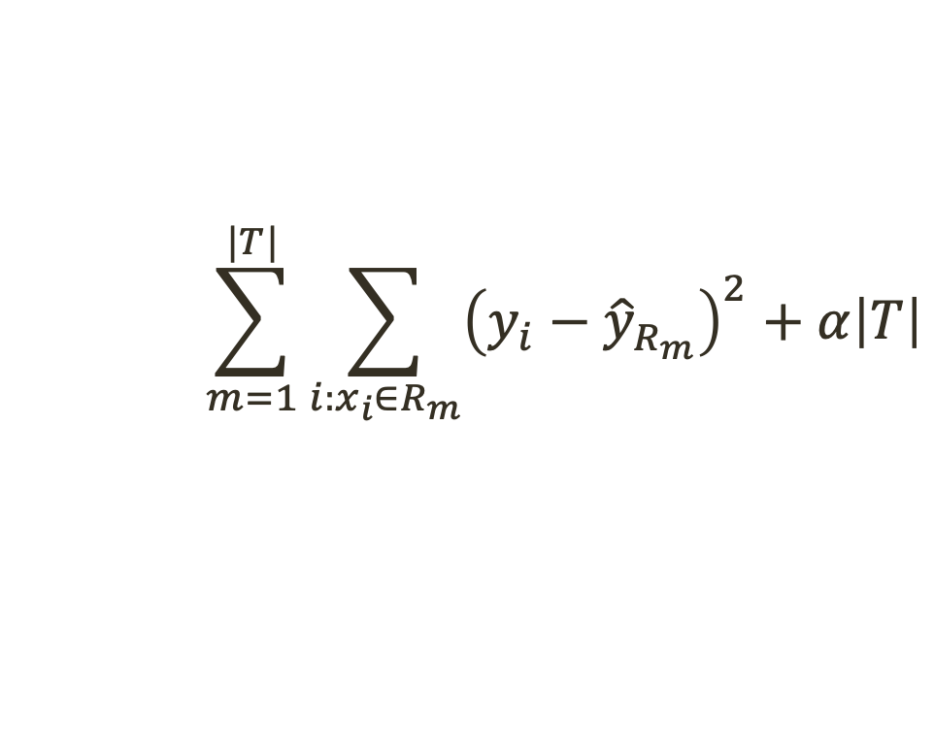
Cost complexity pruning
Big idea: minimize RSS plus an additional penalty that rewards small trees
RSS
Shrinkage
penalty
$$\sum_{m=1}^{|T|}{\sum_{i:x_{i}∈R_{m}}{{\left(y_{i}−{\hat{y}}_{R_{m}}\right)}^{2}}+α\left|T\right|}$$
Rewards
trees with
fewer
terminal nodes
Difference b/t
true & predicted
values
Loop over
all terminal nodes
Then consider
only the
relevant predictors

Slide 29
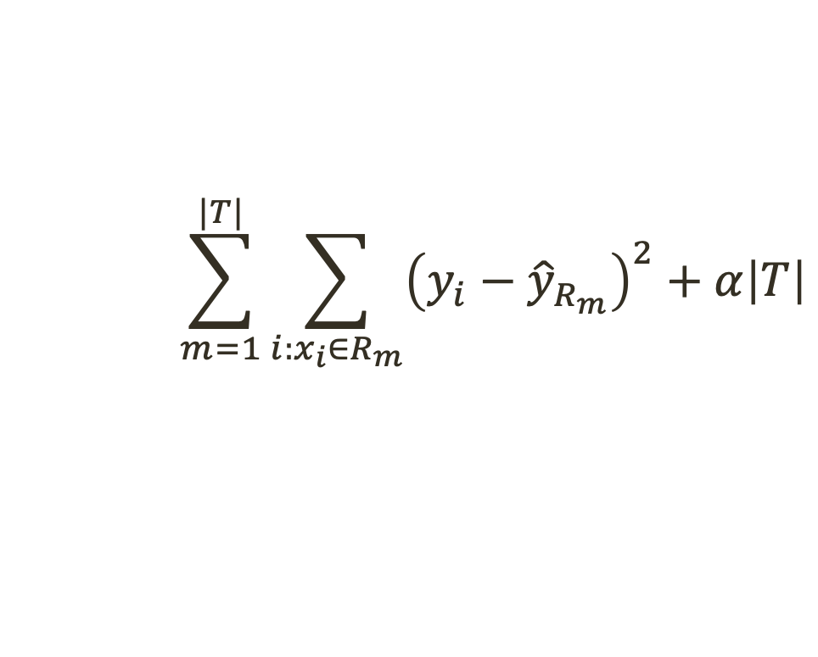
Cost complexity pruning
Big idea: minimize RSS plus an additional penalty that rewards small trees
Fun fact: as we increase α, branches get pruned in a nice, predictable (nested) fashion (why is this useful?)
RSS
Shrinkage
penalty
$$\sum_{m=1}^{|T|}{\sum_{i:x_{i}∈R_{m}}{{\left(y_{i}−{\hat{y}}_{R_{m}}\right)}^{2}}+α\left|T\right|}$$

Slide 30
Tree variation of backward selection
Start by growing some big tree on the training data
Use cost complexity pruning to get a sequence of “best subtrees” (as a function of α)
Select a single “best” α using cross-validated prediction error or something similar
Return the associated tree

Slide 31
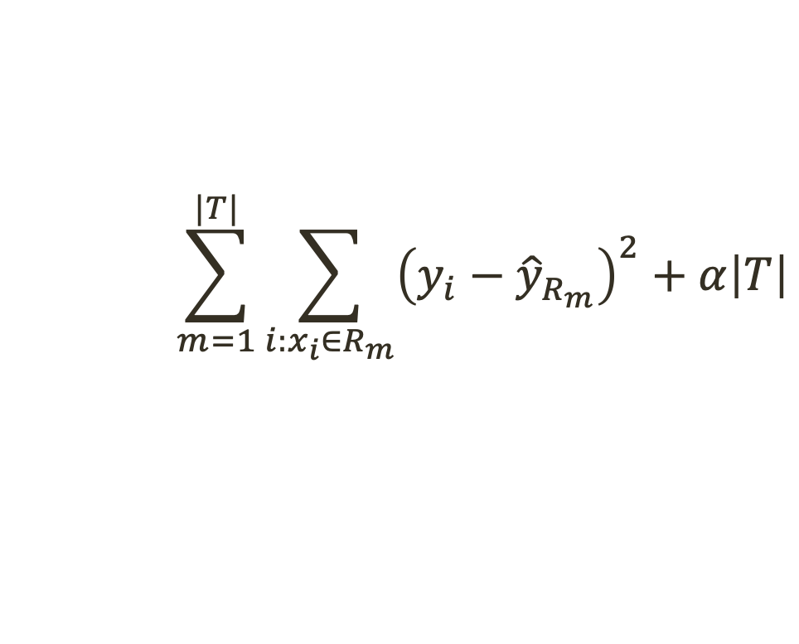
Discussion
The minimization we just saw would help us find the best regression tree, but our example was about classification
Question: what needs to change?
Answer: just like in previous classification settings, we can’t use RSS
$$\sum_{m=1}^{|T|}{\sum_{i:x_{i}∈R_{m}}{{\left(y_{i}−{\hat{y}}_{R_{m}}\right)}^{2}}+α\left|T\right|}$$

Slide 32
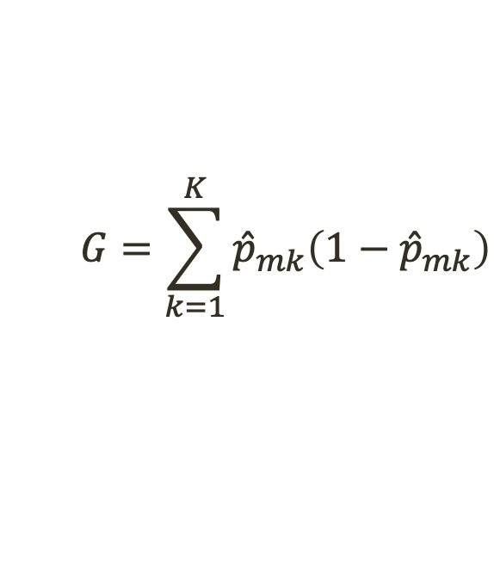
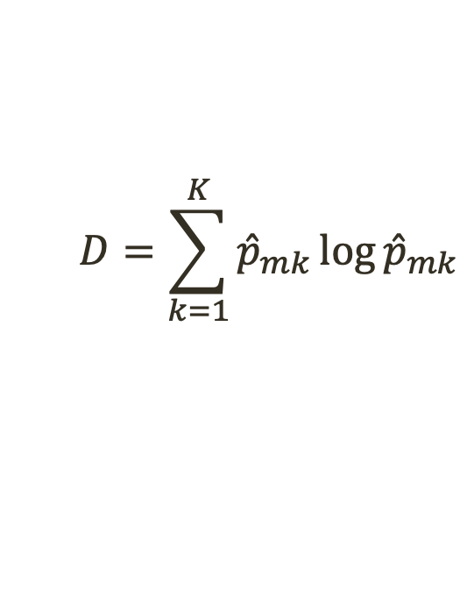
Trouble in paradise…
Usual approach (minimizing classification error) isn’t sensitive enough to build good trees
Alternative 1: Gini index of each node
Alternative 2: cross-entropy of each node
Both are measures of purity*
$$G=\sum_{k=1}^{K}{{\hat{p}}_{mk}\left(1−{\hat{p}}_{mk}\right)}$$
$$D=\sum_{k=1}^{K}{{\hat{p}}_{mk}\log{{\hat{p}}_{mk}}}$$
*small values → node contains mostly observations from the same class
Notes:
P_mk is the probabiity the terminal node

Slide 33
Discussion
What advantages / disadvantages might decision trees have when compared to other methods?
Notes:
Answer:
Easy to explain and interpret
Don’t need dummy variables to handle qualitative predictors
Decision trees may more closely mirror human decision-making
With what we’ve seen with so far*, trees aren’t going to be as accurate as other methods we’ve discussed

Slide 34
Activity
Use the Hitters dataset (in the ISLP package)
Consider these variables:
Years, Hits, RBI
We will use these three variables to create a decision tree that predicts Salary.
Start by dropping any players with NA salary.
Then, decide which variable to use for your first split, and what value of that variable to split around.
Then repeat until you have 4-6 terminal nodes.
Draw your decision tree.

